Slide 1
GOOGLE GENERATIVE AI OPEN SOURCE LLM “GEMMA MODEL INTEGRATION WITH HUGGING FACE, GROQ , LANGCHAIN”
Top Trending course across in the world
Job Market: 2024 – 2030
DATA SCIENCE FOR EVERYONE
K. Prakash Senapati

Slide 2
AGENDA FOR TODAY SESSION
Self Introduction
Introduce to Gemma model
Introduce to Hugging face
Introduce to Groq
Introduce to Langchain
PRACTICLE:1 → GEMMA MODEL INTEGRATE WITH HUGGING FACE
PRACTICLE:2 → GEMM MODEL INTEGRATE WITH LANGCHAIN, HUGGING FACE & GROQ
About my New batch & new Batch link
Previous Generative AI Youtube videos
LinkedIn connection
Q & A

Slide 3
MY SELF INTRODUCTION

Slide 4
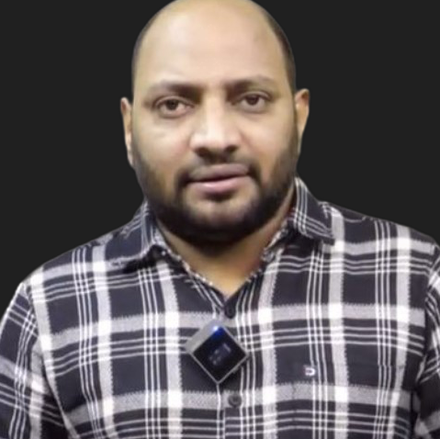
MY INTRODUCTION
LEAD DATASCIENTIST @ NARESH IT → K. PRAKASH SENAPATI
INDUSTRY EXPERIENCE → 17+YRS
WORK EXPERIENCE→ KROGER IT | GENPACT | VALUELABS | MPHASIS | ITFAS | KIABI | A3MAX |
TEACHING EXPERIENCE → SYNERGISTIC SOFTWARE SOLUTIONS | IIIT-BANGALORE UPGRADE |
GREAT LEARNING | CORPORATE TRAINER | NARESH IT
PERMANENET WORKING CLIENT → EUROPEAN BASED CLIENT
TRAINING MODE→ OFFLINE & ONLINE
OFFLINE LOCATION→ AMEERPET, HYDERBAD
OFFLINE LAB → PHYSICAL LAB & ONLINE LEARNER → VIRTUAL LAB
DURATION→ 5-6 MONTHS & TIME →
CLASS DAY→ MON - FRI || 2nd & 4th WEEK– SATURDAY
MICROSOFT CERTIFIED DATASCIENTIST
GOOGLE CERTIFIED GENERATIVE AI ENGIEER
youtube.com/watch?v=TR_OCx5z-m8&t=98s
LINKEDIN →https://www.linkedin.com/in/kodi-prakash-senapati-a95a60182/

Slide 5
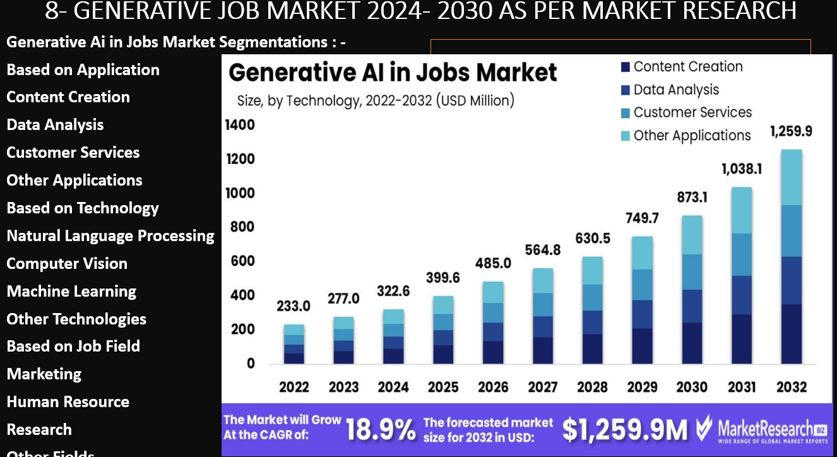

Slide 6
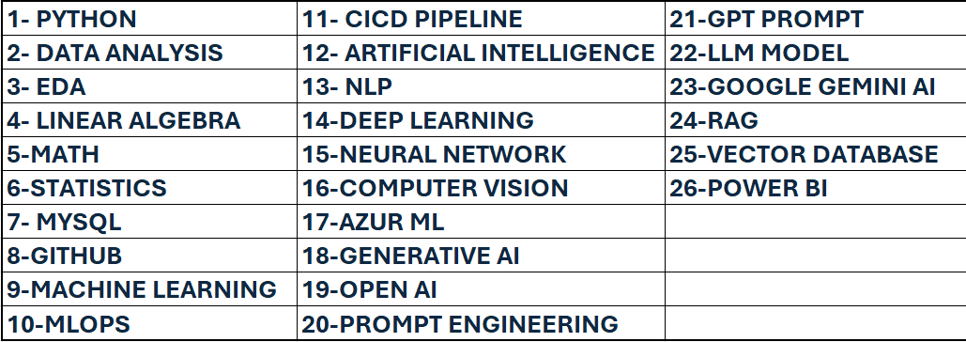
KEY TOPICS OF THIS COURSE
EVERY TOPIC EXPLANATION FROM BASIC LEVEL TO EXPERT LEVEL

Slide 7

WHO ARE ELIGIBLE TO LEARN THIS COURSE
High school (10th) || College (12th) || Students can learn this for upskills in future world but not for apply the Job
College (BSC || BCOM || BA)
Engineering || B. Tech (Mechanical || Chemical || Computers || Electrical || civil || All Stream)
BBA || BCA || BE || Diploma || Pharma || B.ED ||
MBA || MCA || ME || M.SC || M.ED
Charted Account || Doctor
Teacher || Lecturer || Assistant Professor || Professor
Person who had career gap he is also learn this course and get the job
No Software Background is required || No Coding background is required
No mathematics background || Not required Linear algebra concept

Slide 8
1: GENERATIVE AI KEY TOPICS COVERED FOR GENERATIVE AI & PROMPT ENGINEERING
LLM MODEL ➔
OPEN AI ➔ LANGCHAIN FRAMEWORK
OPEN AI WHISPER
GOOGLE ➔ GEMINI AI
GEMMA
GOOGLE VISION
META ➔ LLAMA2
ANTHROPIC ➔ CLAUDE
BUILD GENERARTIVE AI ON CLOUD
FOUNDATION MODEL
FINE TUNE LLM MODEL WITH QUANTIZATION,LORA & QLORA
RETRIEVAL AUGMENTED GENERATION (RAG)
HUGGING FACE
CREW AI
GROQ
STABLE DIFFUSION
GITHUB COPILOT
ZERO-SHOT PROMPT
FEW-SHOT PROMPT
FALCON
MISTRAL 7B
FAST API
VECTOR DATABASE

Slide 9
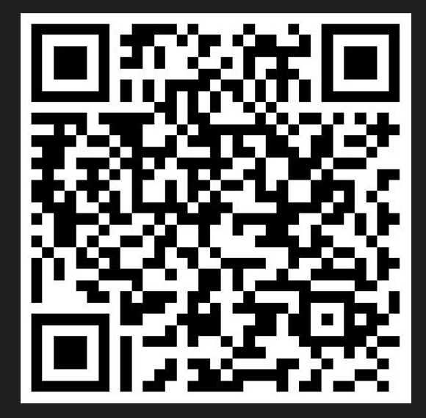
NEW BATCH 5-DEMO VIDEO
Full Stack DATA SCIENCE & AI Sessions! by Mr. Prakash Senapathi
👉 Follow 5 Days Recorded Sessions
Day-1: https://shorturl.at/hJYkz
Day-2: https://shorturl.at/I8anD
Day-3: https://shorturl.at/6qaMk
Day-4: https://shorturl.at/tvpi3
Day-5: youtube.com/watch?v=z3J86w2OOAE&t=540s
📁 Drive Link: https://shorturl.at/lAB5R

Slide 10
PREVIOUS YOUTUBE VIDEO
1- https://www.youtube.com/watch?v=VqOB5DH53LI&t=6373s ( MASTERING DS & AI)
2- https://www.youtube.com/watch?v=tTT7XJO30cM&t=6861s (EDA )
3- https://www.youtube.com/watch?v=Xnuy16SbpBk&t=2115s (NLP TECHNIQUE)
4- https://www.youtube.com/watch?v=eDN6fAWLNNE&t=7118s ( META LLM)
5- https://www.youtube.com/watch?v=BDrXdvNh19Q&t=3308s (GEMINI LLM)
6- https://www.youtube.com/watch?v=MAkXifYHnuw&t=1335s ( OPEN AI LLM)
7- https://www.youtube.com/watch?v=SDStCnlITT8&t=1393s (CHATGPT)
8- https://www.youtube.com/watch?v=PhIAQ8rE2xc&t=1220s (DS SOFTWARE INSTALLA)
9- https://www.youtube.com/watch?v=u-ym7BWHO-g&t=3826s (COMPUTER VISION)
10- https://www.instagram.com/p/C9ceBAnS89f/ ( PLACEMENT1)
11- https://www.instagram.com/p/C9Rz6v5yXh4/ (PLACEMENT2)
12- https://www.instagram.com/nareshitech/ (PLACEMENT3)
13- https://www.instagram.com/reel/C7LgTtFgClO/ (PLACEMENT4)

Slide 11



